Slide 1
classifying surgical gestures can be helpful for characterize surgeon performance

Slide 2
Prior works

Slide 3
Using augmentation to improve the robustness to rotation of deep learning segmentation in robotic-assisted surgical data Danit Itzkovich, Yarden Sharon, Anthony Jarc, Yael Refaely, Ilana Nisky
Using simple LSTM architecture, trained and tested with the JIGSAWS dataset.
demonstrate poor generalization when attempting to classify the gestures of clinical-like surgical tasks.

Slide 4
Generalization of Deep Learning Gesture Classification in Robotic-Assisted Surgical Data: From Dry Lab to Clinical-Like Data Danit Itzkovich, Yarden Sharon, Anthony Jarc, Yael Refaely, Ilana Nisky

Slide 5
The contribution of their work is a guideline of how to generalize algorithms trained on structured dry-lab datasets to real surgical data.
They unsuccessfully attempted to improve performance using several common techniques, such as data augmentation and transfer learning. In contrast, they demonstrate that using the same network architecture together with additional features and training on even a small clinical-like dataset leads to promising classification performance.

Slide 6
Datasets

Slide 7
JIGSAWS dataset

Slide 8
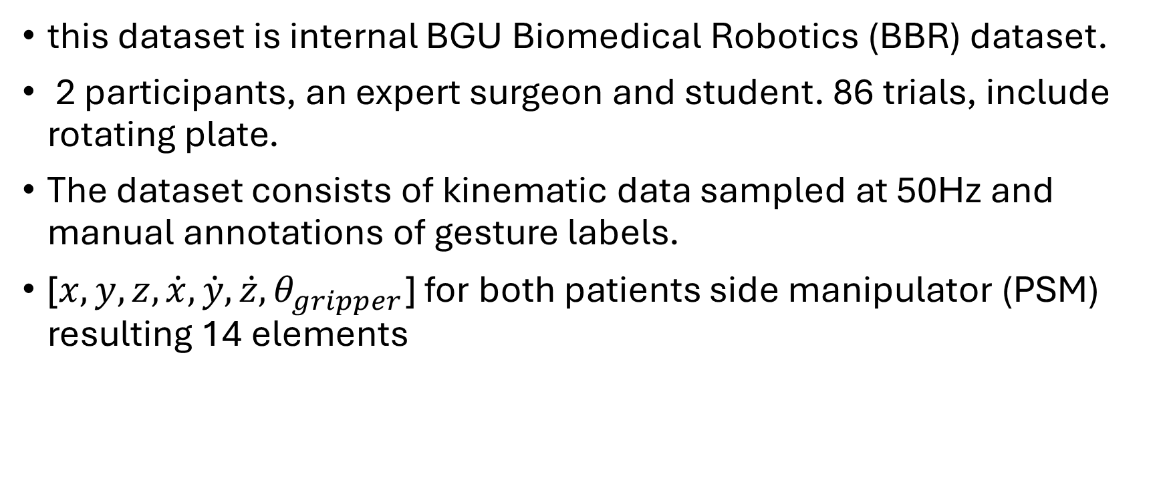
BBR dataset
this dataset is internal BGU Biomedical Robotics (BBR) dataset.
2 participants, an expert surgeon and student. 86 trials, include rotating plate.
The dataset consists of kinematic data sampled at 50Hz and manual annotations of gesture labels.
[$x,y,z,\dot{x},\dot{y},\dot{z},θ_{gripper}$] for both patients side manipulator (PSM) resulting 14 elements

Slide 9
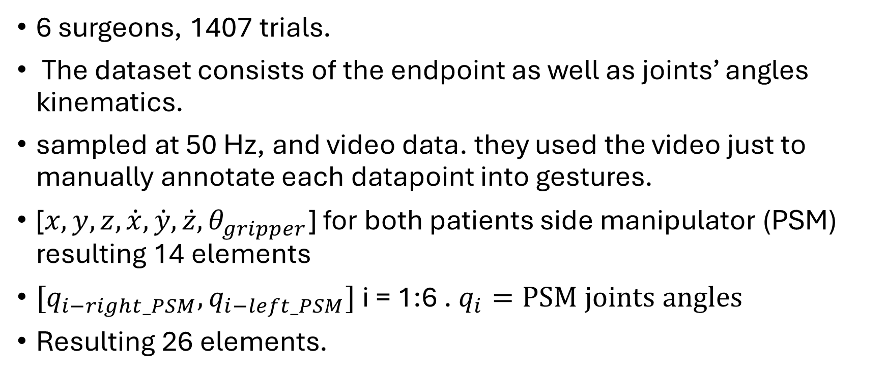
clinical-like dataset
6 surgeons, 1407 trials.
The dataset consists of the endpoint as well as joints’ angles kinematics.
sampled at 50 Hz, and video data. they used the video just to manually annotate each datapoint into gestures.
[$x,y,z,\dot{x},\dot{y},\dot{z},θ_{gripper}$] for both patients side manipulator (PSM) resulting 14 elements
$[q_{i−right_PSM},q_{i−left_PSM}]$ i = 1:6 . $q_{i}=PSM joints angles$
Resulting 26 elements.

Slide 10
Model

Slide 11
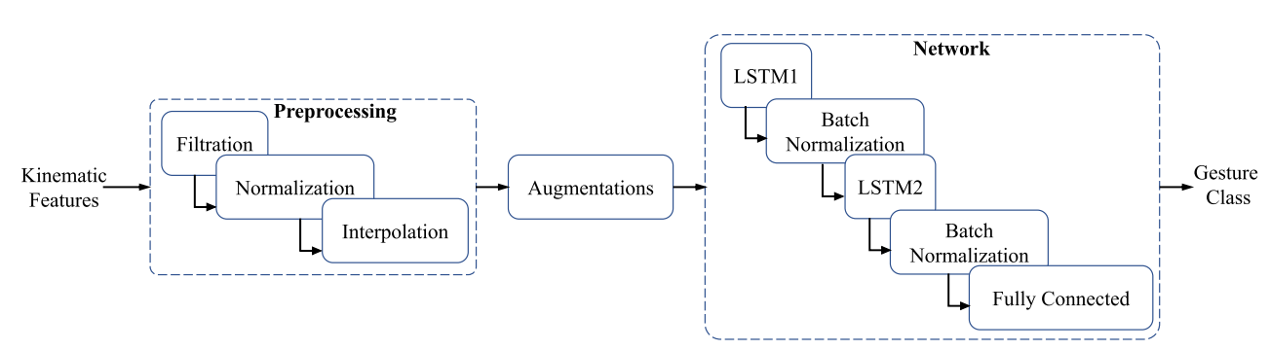

Slide 12
Different Training and Testing Approaches and their results

Slide 13
Simple JIGSAWS network
Trained on JIGSAWS.
Tested on JIGSAWS, BBR, and Clinical-like data.
Did not generalize well to other datasets

Slide 14
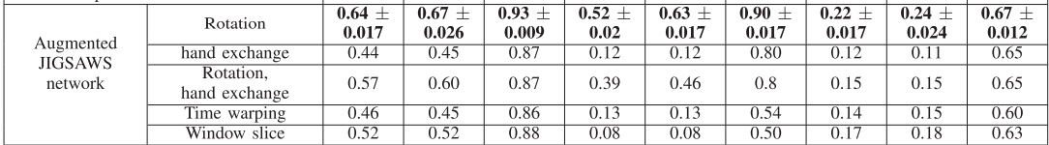
Augmented JIGSAWS network
Trained on data Augmentation of JIGSAWS (rotation, time warping, left-right hand exchange, window slicing).
Tested on JIGSAWS, BBR, and Clinical-like data.
Improved performance on dry-lab data but not on clinical-like data.

Slide 15
Transfer Network
pre-trained on JIGSAWS, then fine-tuned on Clinical-like data (without extra features).
Tested on Clinical-like data.
Helped, but still not sufficient for good generalization

Slide 16
Simple like clinical Network – extra features comparison
Both networks Trained on clinical like dataset. One network “JIGSAWS features” trained on 14 features, the second network “clinical-like features” trained on 26 features
Both Tested on Clinical-like data.

Slide 17
Augmented clinical like Network
Trained with augmented clinical like dataset to create larger dataset.
Test on clinical like dataset
Achieved the best results in clinical like dataset test.

